Slide 1

Intro to
Programming
With python
classes:
part 1
Wednesday, April 30 2025 TOH210
Notes:
Layout objects pulled from: https://slidesgo.com/
All icons are from: https://thenounproject.com/

Slide 2

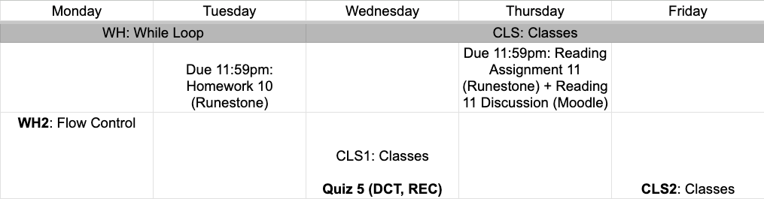
This week
google sheet link
Note: Thursday office hours are 2:30-3:30pm
Notes:
https://docs.google.com/forms/d/e/1FAIpQLSe3OloPAJSid4n6cyU_4qXpRWU7FOSmP7IVdRS_vh9cvYd9zQ/viewform?usp=sharing

Slide 3
classes 1
Workbook
click for access
found on Moodle under this week

Slide 4


warm-up
Password cracking
Example
>>Password: cherry
Try again
>>Password: grape
Too short!
>>Password: password
Access granted
Write a program that keeps asking the user to enter a password until they type the correct one ("password").
If the user enters a password shorter than 6 characters, print "Too short!" and skip to the next iteration using continue.
If the user types "password", print "Access granted." and end the loop using break.
Otherwise, print "Incorrect password." and ask again.
An outline has been provided for you

Slide 5
Takeaways from last time
break leaves a loop completely
continue helps to filter things from loop body
pass does nothing, but helpful when doing procedural programming

Slide 6

What is a class?
real world examples
anything that has a state (data/attributes/variables) and behaviors (functions/methods)
person: state (age, height, hair_color); behavior(move, talk, code)
clock: state (price, material, color); behavior(display_time, set_alarm)
What are some attributes and behaviors for a dog class?
Dog: state ( );
behavior ( )

Slide 7
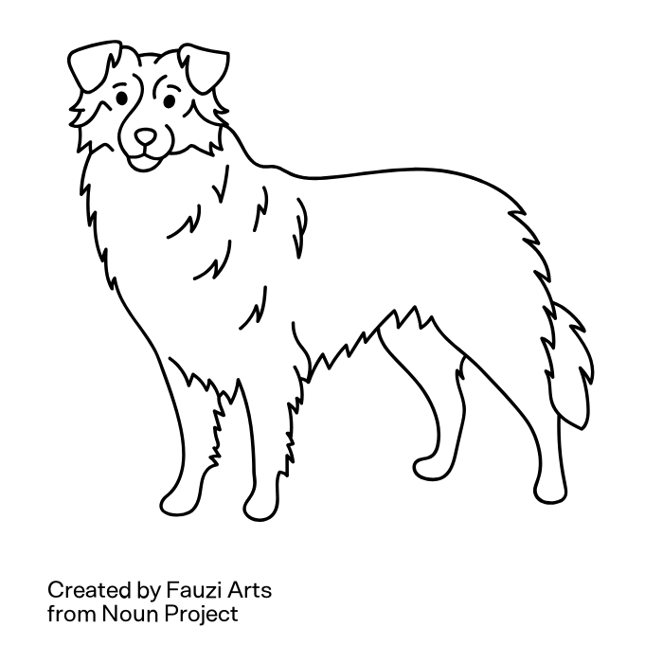
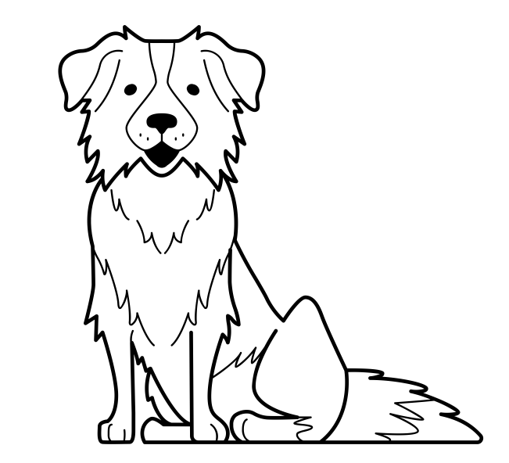
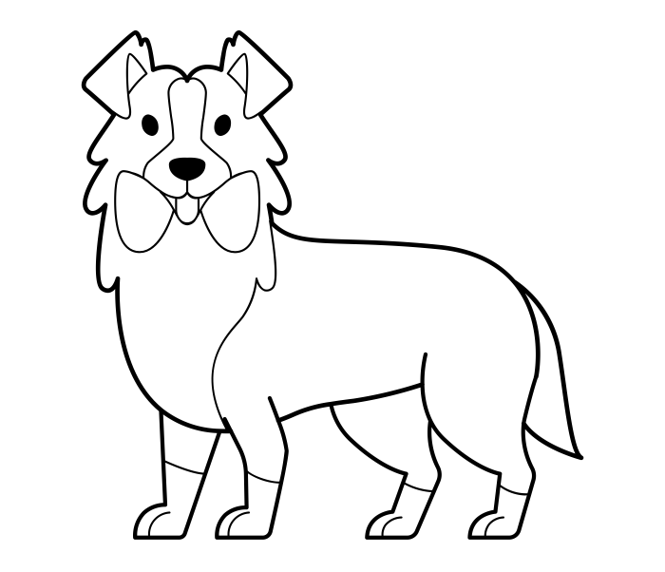
class
methods of DOG class:
sit, bark, run, chew
dog
eowyn.bark()
method of DOG class that interacts with the instance eowyn
woof
meriadoc.bark()
method of DOG class that interacts with the instance meriadoc
pippin.sit()
method of DOG class that interacts with the instance pippin
woof
eowyn
pippin
meriadoc
instance of DOG class
instance of DOG class
instance of DOG class

Slide 8
always capitalized
a keyword that initializes a class, followed by the name of the class
defining a class
1
class Class_name:
def __init__(self, parameters):
attributes
def method1(self):
behavior
2
every function definition needs to have the self parameter
attributes (also called data, or variables)are used to initialize an instance of an object
function definitions go inside the class definition
3
methods (functions, or behaviors)can use attributes to do things with the instance

Slide 9
member attributes
are initialized using the initializer method __init__ (also called the constructor).
these attributes are what we reference later on when we create methods (behaviors) for our objects
class Class_name:
def __init__(self, value):
self.attribute = value
call self which is referencing the object
name of the attribute (member variable)
value it is initialized to
instances of Dog class
class Dog:
def __init__(self, n:str, a:int, b:str):
self.name = n
self.age = a
self.breed = b
eowyn = Dog("Eowyn", 3, "Mutt")
pip = Dog("Pip", 10, "Aussie")
mera = Dog("Mera", 6, "Mini Aussie")

Slide 10
member methods
are created like regular functions, but always need to be passed self as a parameter
these methods are how we can interact with our objects and change or display values stored in the attributes
class Class_name:
def behavior_1(self):
#do stuff with attribute(s)
accessor
this is a method that retrieves (returns) a value of an attribute
mutator
this is a method that changes a value of an attribute (does not return)

Slide 11
class Dog:
def __init__(self, n, a, b):
self.name = n
self.age = a
self.breed = b
try this out for yourself!
add another method called get_age that will return the dog’s age
is it an accessor or a mutator?
constructor
accessor
def get_name(self):
return self.name + “the” + self.breed
def birthday(self):
self.age += 1
mutator

Slide 12
We will stop by 12:30 or 1:35 for Quiz 5
exercise
student class
Define a class called Student, with the following:
member variables
last_name: a string given as an argument to the constructor
first_name:a string given as an argument to the constructor
dorm: a string given as an argument to the constructor
member functions
get_name: returns the full name of the student: “<first_name> <last_name>”
move: take the name of a dorm as an argument, changes the student's dorm to that one.

Slide 13

before next time
Finish workbook
Continue Project 9

Slide 14
Password cracking
while True:
password = input("Password: ")
if len(password)<6:
print("Too short!")
continue
elif password == "password":
print("Access granted")
break
else:
print("Try again")

Slide 15
class Dog:
"""Dog class that stores age and breed"""
def __init__(self, n:str, a:int, b:str): #constructor
self.name = n
self.age = a
self.breed = b
def get_name(self): #accesor
"""Returns the name and breed of the dog """
return self.name + " the " + self.breed
def birthday(self): #mutator
"""Adds one to the age of the dog"""
self.age += 1
def get_age(self): #accessor
"""Returns the age of the dog"""
return self.age

